Slide 1
Chapter 4 The Enhanced E-R Model and Business Rules

Slide 2
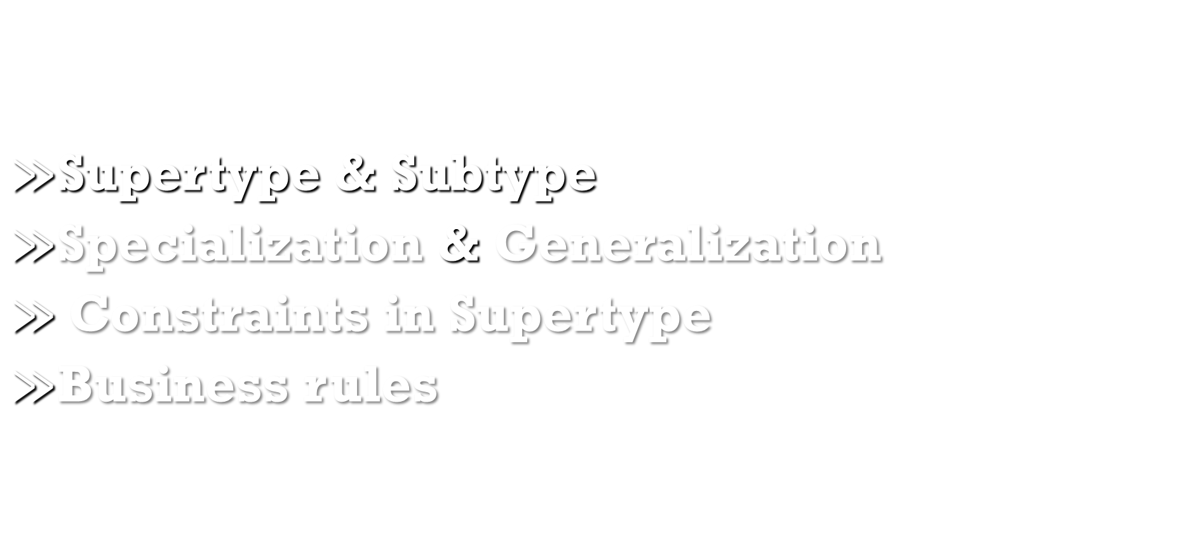
Agenda
$≫$Supertype & Subtype
$≫$Specialization & Generalization
$≫$Constraints in Supertype
$≫$Business rules

Slide 3
Supertype & Subtype
-Subtype: A subgrouping of the entities in an entity type which has attributes that are distinct from those in other subgroupings
-Supertype: An generic entity type that has a relationship with one or more subtypes
-Inheritance
>Subtype entities inherit values of all attributes of the supertype
>An instance of a subtype is also an instance of the supertype

Slide 4
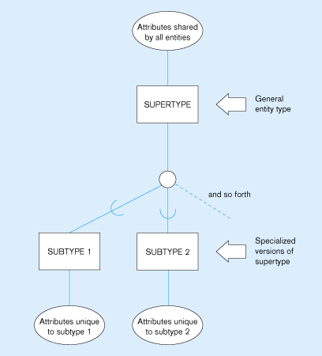
Supertype & Subtype
Figure 4-1-Basic notation for supertype/subtype relationships

Slide 5
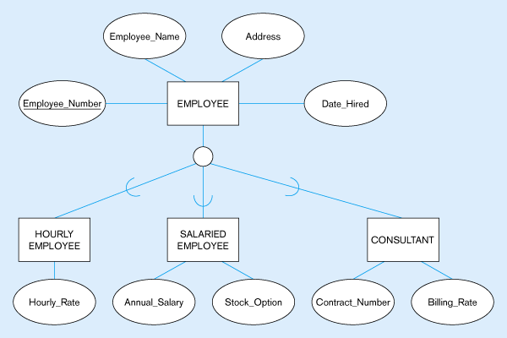
Supertype & Subtype
Figure 4-2 - Employee supertype with three subtypes

Slide 6
Supertype & Subtype
>Relationships and Subtypes
-Relationships at the supertype level indicate that all subtypes will participate in the relationship
-The instances of a subtype may participate in a relationship unique to that subtype. In this situation, the relationship is shown at the subtype level

Slide 7
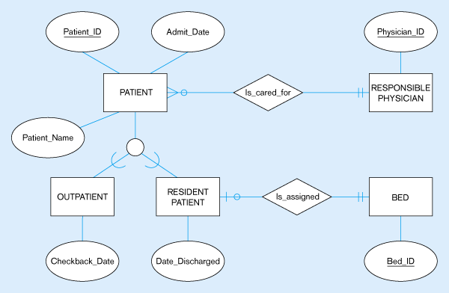
Supertype & Subtype
Figure 4-3 - Supertype/
subtype relationships in a hospital

Slide 8
Specialization & Generalization
Specialization: The process of defining one or more subtypes of the supertype, and forming supertype/subtype relationships. TOP-DOWN
Generalization: The process of defining a more general entity type from a set of more specialized entity types. BOTTOM-UP

Slide 9
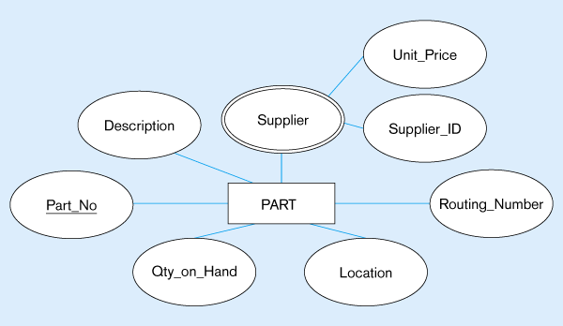
Specialization & Generalization
Figure 4-5 – Example of specialization
a) Entity type PART

Slide 10
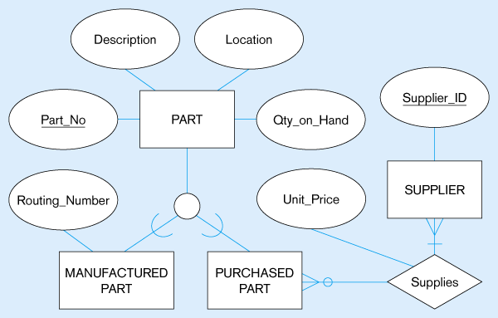
Specialization & Generalization
Figure 4-5(b) –
Specialization to MANUFACTURED PART and PURCHASED PART
Note: multivalued attribute was replaced by a relationship to another entity

Slide 11
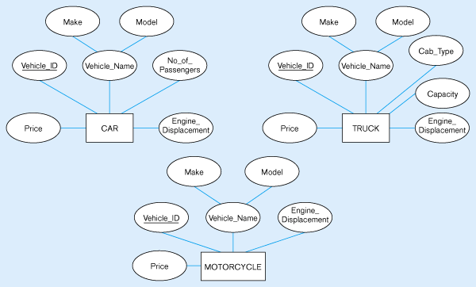
Specialization & Generalization
Figure 4-4 – Example of generalization
a) Three entity types: CAR, TRUCK, and MOTORCYCLE

Slide 12
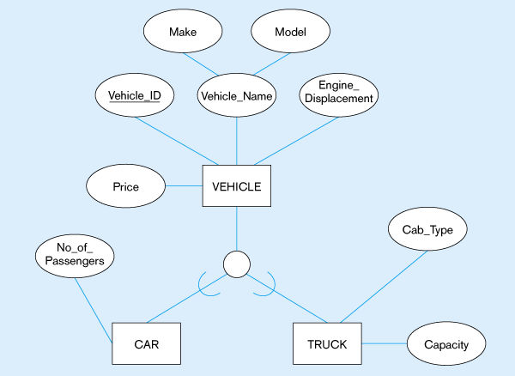
Specialization & Generalization
Figure 4-4(b) – Generalization to VEHICLE supertype
Note: no subtype for motorcycle, since it has no unique attributes

Slide 13
Constraints in Supertype
>Constraints of Supertype
1) Disjointness Constraints
2) Completeness Constraints

Slide 14
Constraints in Supertype
> Disjointness Constraints
Whether an instance of a supertype may simultaneously be a member of two (or more) subtypes.
-Disjoint Rule: An instance of the supertype can be only ONE of the subtypes
-Overlap Rule: An instance of the supertype could be more than one of the subtypes

Slide 15
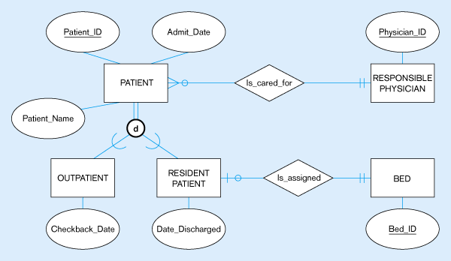
Constraints in Supertype
Figure 4-7 – Examples of disjointness constraints
a) Disjoint rule

Slide 16
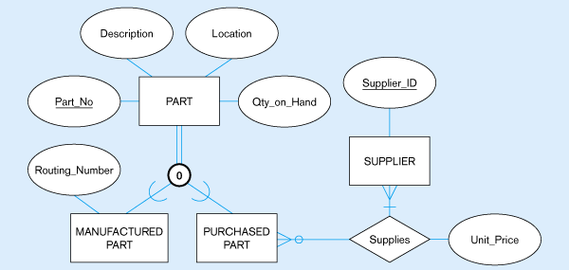
Constraints in Supertype
Figure 4-7
b) Overlap rule

Slide 17
Constraints in Supertype
> Completeness Constraints
Whether an instance of a supertype must also be a member of at least one subtype
Total Specialization Rule: Yes (double line)
Partial Specialization Rule: No (single line)

Slide 18
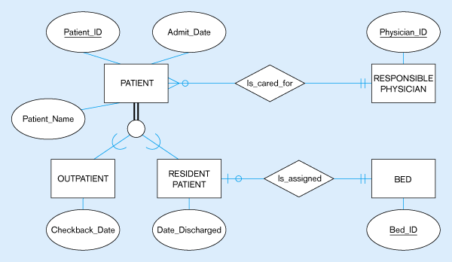
Constraints in Supertype
Figure 4-6 – Examples of completeness constraints
a) Total specialization rule

Slide 19
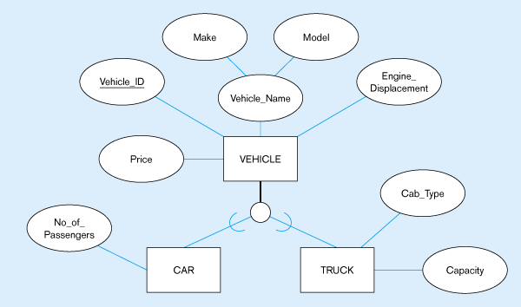
Constraints in Supertype
Figure 4-6
b) Partial specialization rule

Slide 20
Constraints in Supertype
>Subtype Discriminator
An attribute of the supertype whose values determine the target subtype(s)
Disjoint: a simple attribute with alternative values to indicate the possible subtypes
Overlapping: a composite attribute whose subparts pertain to different subtypes. Each subpart contains a boolean value to indicate whether or not the instance belongs to the associated subtype

Slide 21
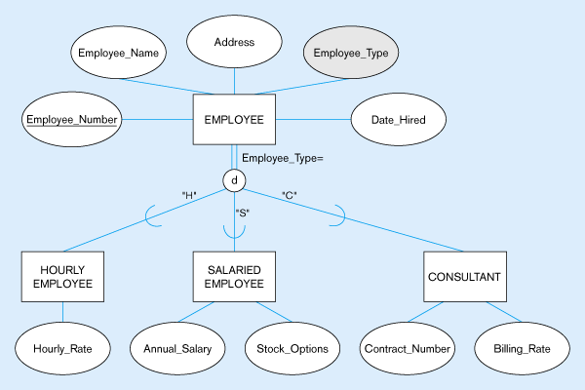
Constraints in Supertype
Figure 4-8 Introducing a subtype discriminator (disjoint rule)

Slide 22
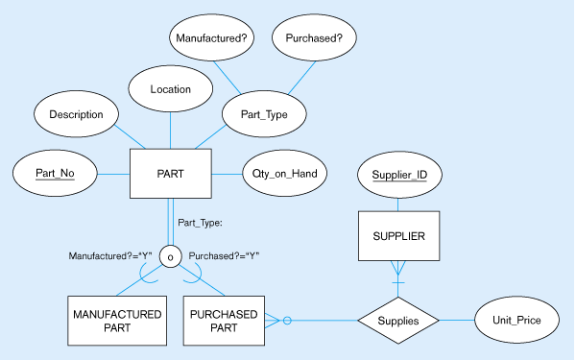
Constraints in Supertype
Figure 4-9
Subtype discriminator (overlap rule)

Slide 23
Business rules
>Business rules
Statements that define or constrain some aspect of the business.
Constraints can impact:
-Structure (definition, domain, relationship)
-Behavior (operational constraints)
Classification of business rules:
-Derivation : rule derived from other knowledge
-Structural assertion : rule expressing static structure
-Action assertion : rule expressing constraints/control of organizational actions

Slide 24
Questions…?
Thank you

